Slide 1
Week#04
Data Structures
CS2001
Email: rafia.shaikh@nu.edu.pk

Slide 2
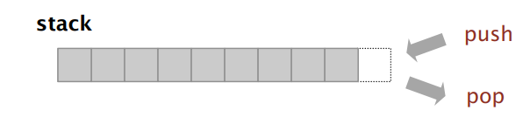
Stack
A stack is a linear data structure that follows the Last-In-First-Out (LIFO) principle. It behaves like a stack of plates, where the last plate added is the first one to be removed.
A stack is an ADT that comprises two basic operations: insert (push) a new item, and remove (pop) the item that was most recently inserted.
Stack. Examine the item most recently added.
LIFO = "last in first out"

Slide 3
Key Operations
Push: Adds an element to the top of the stack.
Pop: Removes the top element from the stack.
Peek: Returns the top element without removing it.
IsEmpty: Checks if the stack is empty.
IsFull: Checks if the stack is full (in case of fixed-size arrays).

Slide 4
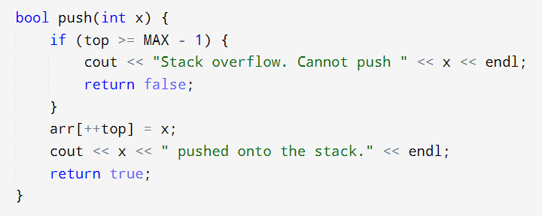
Stack push: array implementation

Slide 5
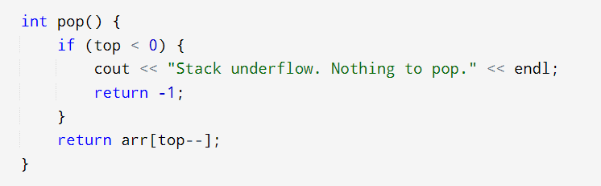
Stack pop: array implementation

Slide 6
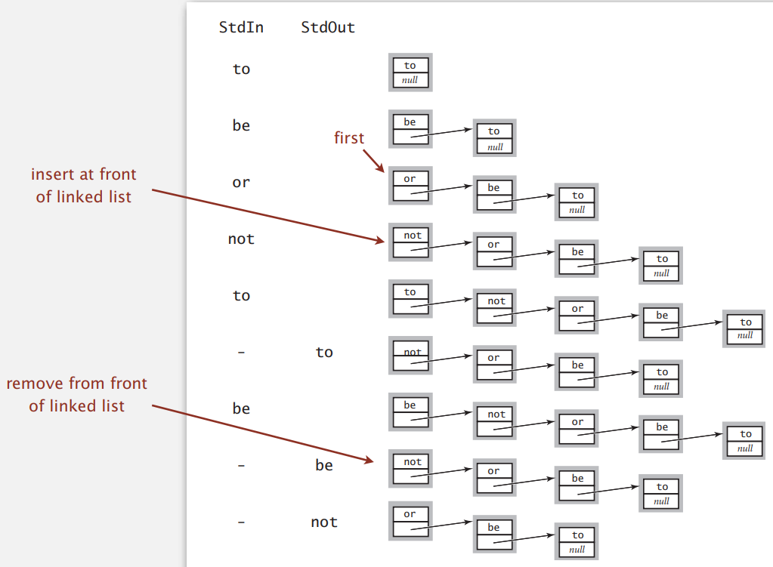
Stack: linked-list representation
Maintain pointer to first node in a linked list; insert/remove from front.

Slide 7
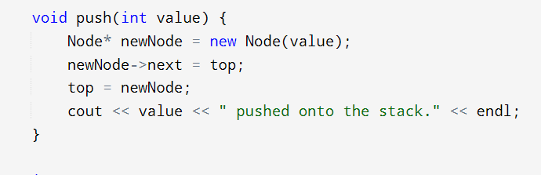
Stack push: linked-list implementation

Slide 8
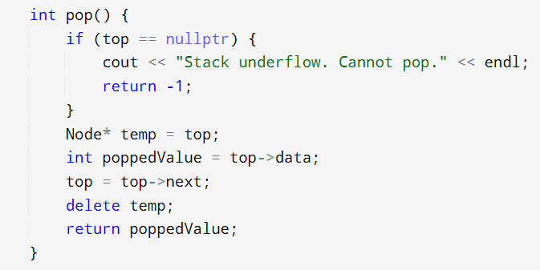
Stack pop: linked-list implementation

Slide 9
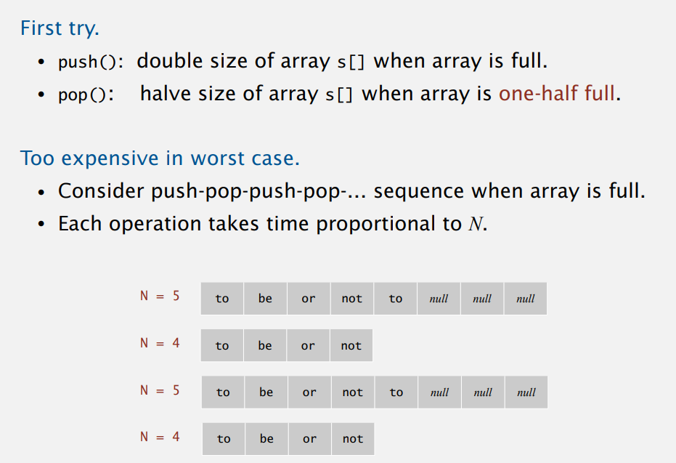
Stack: resizing-array implementation

Slide 10
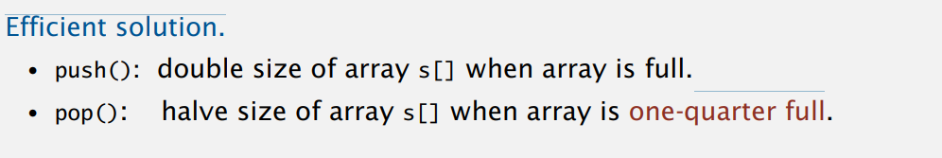
Stack: resizing-array implementation

Slide 11
Application of Stack in Data Structure are as following:
Recursion.
Expression Evaluation and Parsing.
Undo/Redo Operations.
Browser History.
Function Calls.
Depth-First Search (DFS)
Backtracking
Delimiter Checking
Reverse a Data

Slide 12
Task
Reverse a string using stack

Slide 13
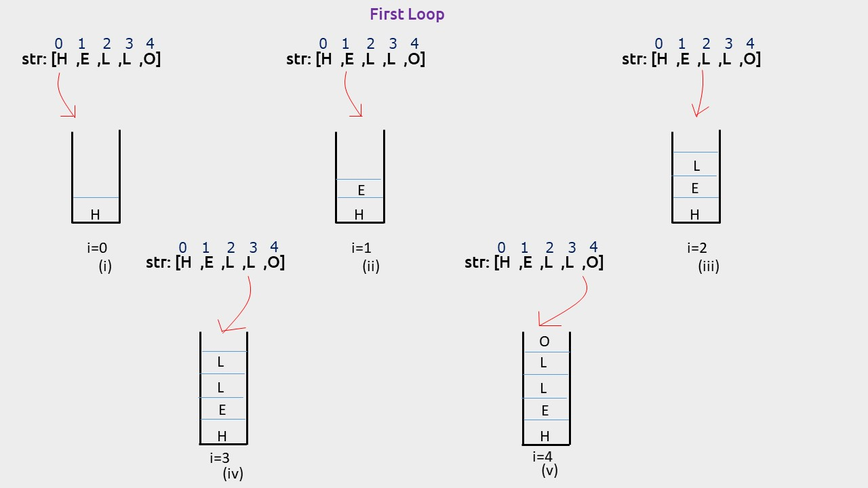
Task
Reverse sequence of strings from standard input

Slide 14
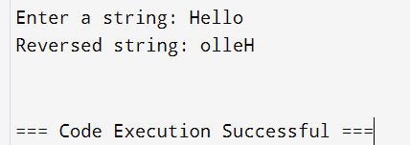
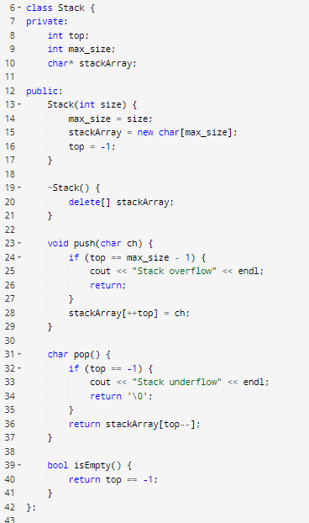
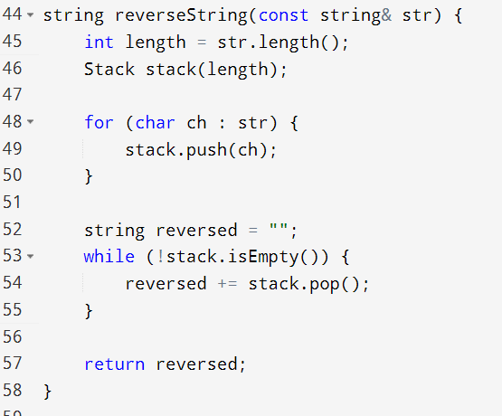
Code

Slide 15
Balanced Brackets
Input: A string str consisting of ‘(‘, ‘)’, ‘[‘, ‘]’ characters.
Output: Return whether or not the string’s parentheses and square brackets are balanced.

Slide 16
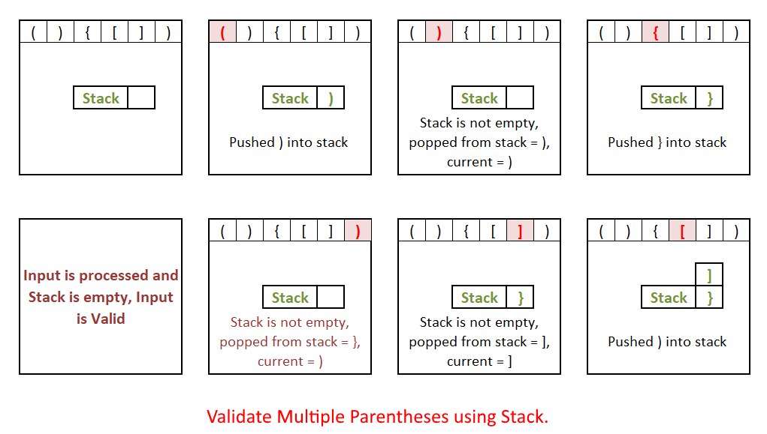
Balanced Brackets

Slide 17
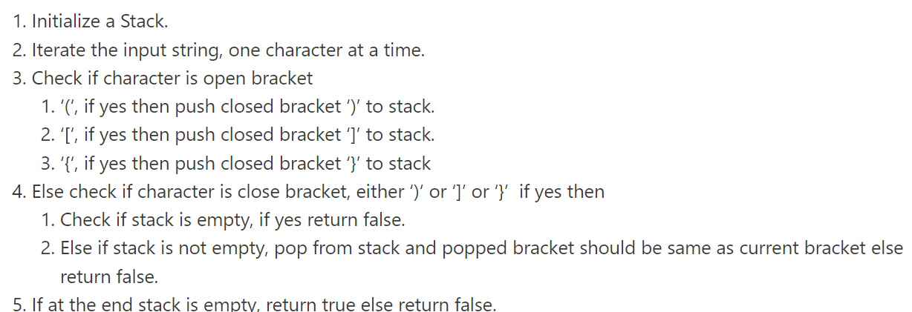
Balanced Brackets Algorithm

Slide 18
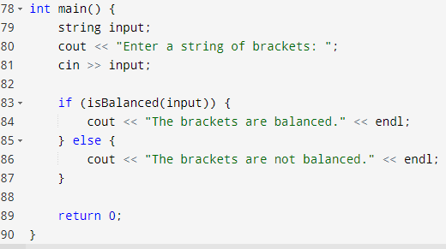
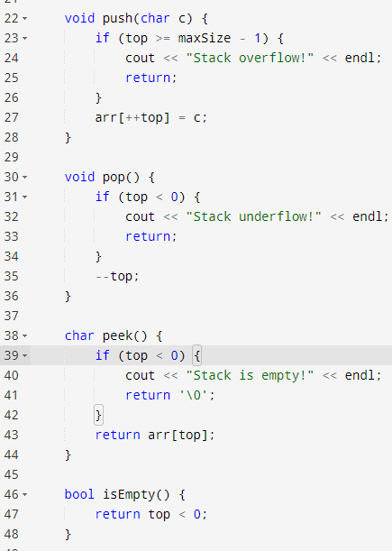
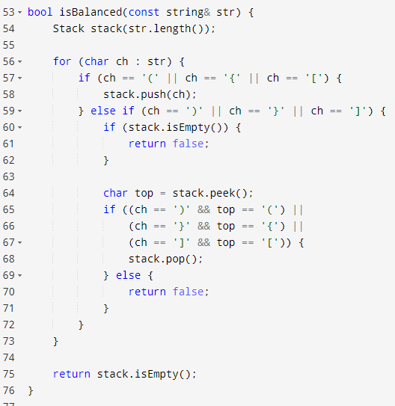
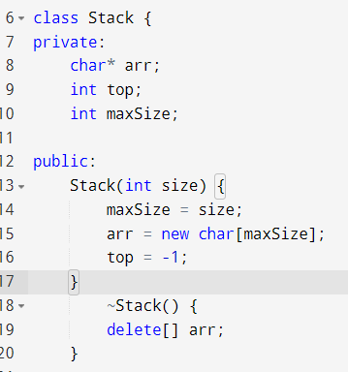
Code

Slide 19
Question
Given the unbalanced string "()([]", what character is on the top of the stack when the for loop is finished?

Slide 20
Answer!
The stack will contain a single value: '(', The procedure will push the initial '(', and then pop it off to match the ')'. It'll then push the next '(', and the '[', and then pop off the '[' to match the ']'. What remains will the the '('.

Slide 21
We will continue this stack topic
One of the stack application is recursion let’s have a look to this topic first

Slide 22
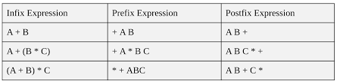
Expression Evaluation
Infix Notation: Operators are written between the operands they operate on, e.g. 3 + 4.
Prefix Notation: Operators are written before the operands, e.g + 3 4
Postfix Notation: Operators are written after operands.

Slide 23
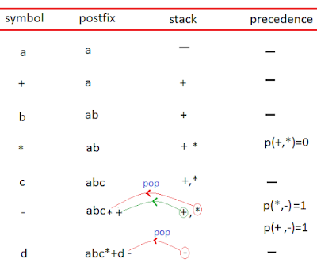
Convert Infix expression to Postfix expression
Create an empty stack S and an empty list output.
Iterate through each character ch in the infix expression:
Operand: If ch is an operand (number/variable), append it to output.
Left Parenthesis (: Push it onto the stack.
Right Parenthesis ):Pop from the stack to output until encountering a left parenthesis (.Discard the left parenthesis.
Operator (+, -, *, /, ^):
While there is an operator on the stack with higher or equal precedence than ch:
Pop from the stack to output.
Push ch onto the stack.
After the loop, pop all operators from the stack to output.
Return the joined output list as the postfix expression

Slide 24
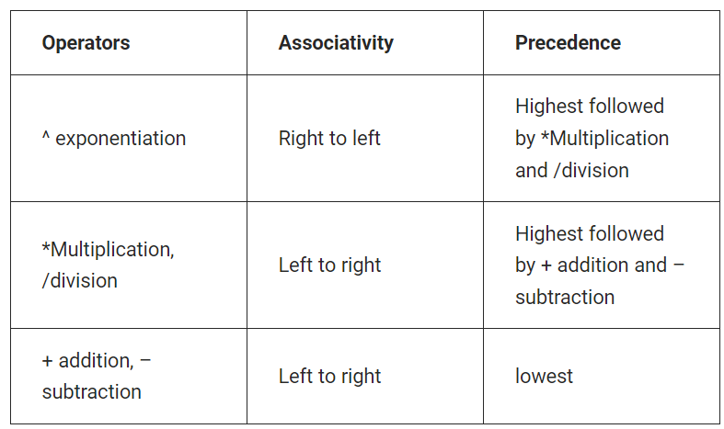

Slide 25
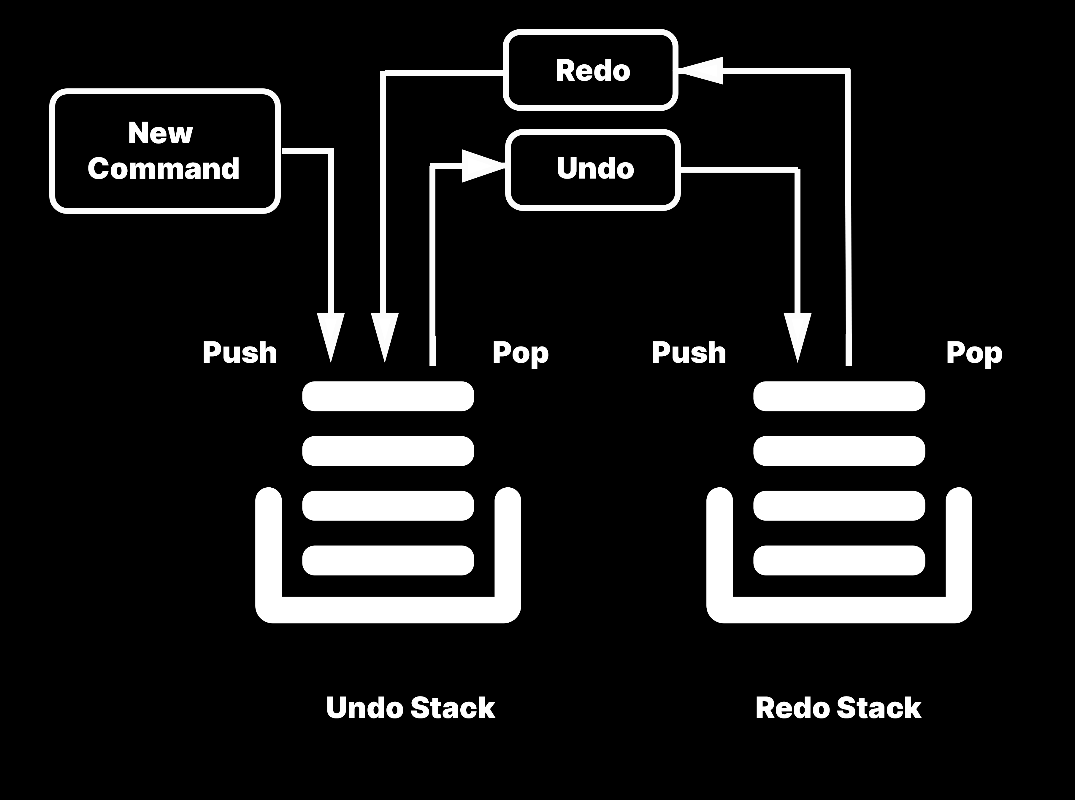
Undo and Redo

Slide 26
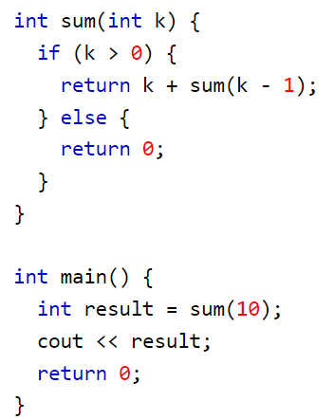
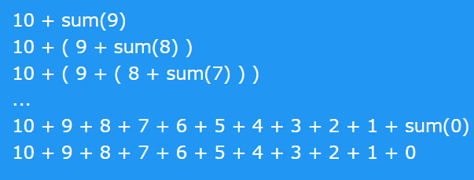
Recursion
The process in which a function calls itself directly or indirectly is called recursion and the corresponding function is called a recursive function.

Slide 27

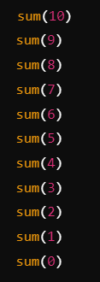
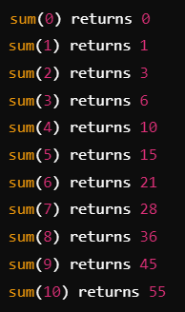
Initial Call
Unwinding
Initial Call: The first invocation of the function (e.g., sum(10)) that triggers the recursion.
Unwinding: The process of resolving each recursive call from the base case back to the original call, combining results and calculating the final value.

Slide 28
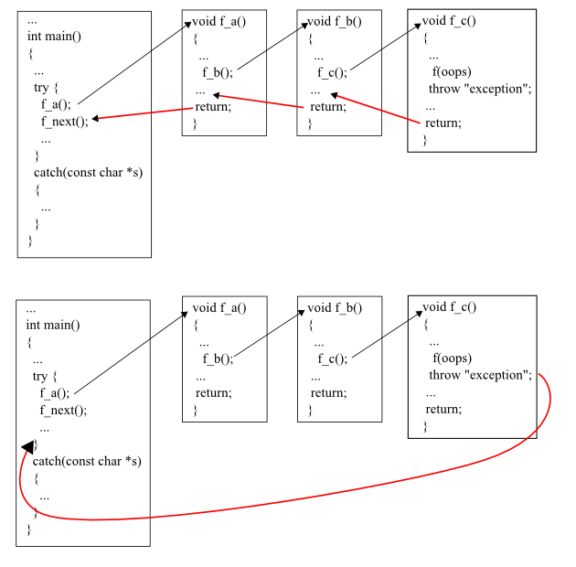

Slide 29
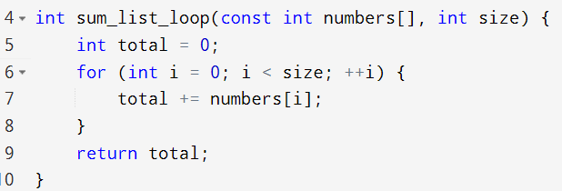
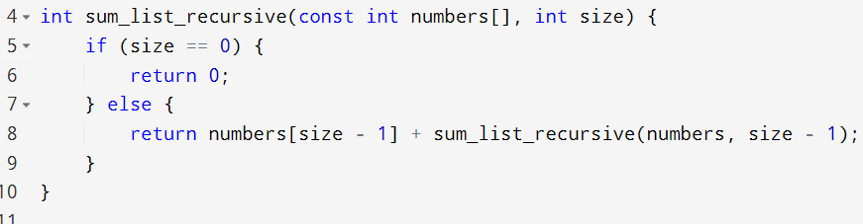
Example#01 – Sum of list of numbers

Slide 30
Recursion | Iteration
Terminates when the base case becomes true. | Terminates when the condition becomes false.
Used with functions. | Used with loops.
Every recursive call needs extra space in the stack memory. | Every iteration does not require any extra space.
Smaller code size. | Larger code size.

Slide 31
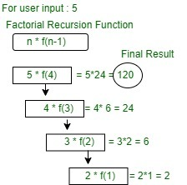
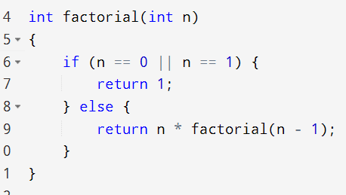
Example#02 – factorial

Slide 32
Advantages / Disadvantages
A lot of algorithms are naturally defined as recursive steps. Using recursion will make these program more clear to understand and elegant to review.
Recursion is memory hungry and a bit slow, you need to have a good reason to use recursion.
In computer science-recursion is generally supported for readability, understandability and clean code.

Slide 33
Classification of Recursion
Tail vs. Non-Tail
Direct vs. Indirect vs. Nested
Simple vs. Excessive
Nested Recursion

Slide 34
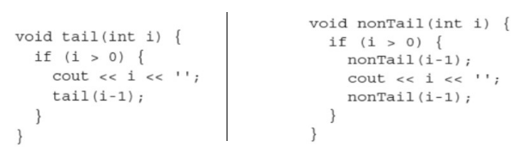
Tail Recursion
Tail Recursion is characterized by the use of only one recursive call at the very end of a function implementation.
This means when a recursive call is invoked there is no work left for the previous call.
Moreover, there is no pending recursive calls, either direct or indirect.

Slide 35
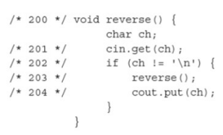
Non-Tail Recursion
Non-Tail recursion is characterized by the fact that there is still some work left for the first call and a recursive self call is invoked.

Slide 36
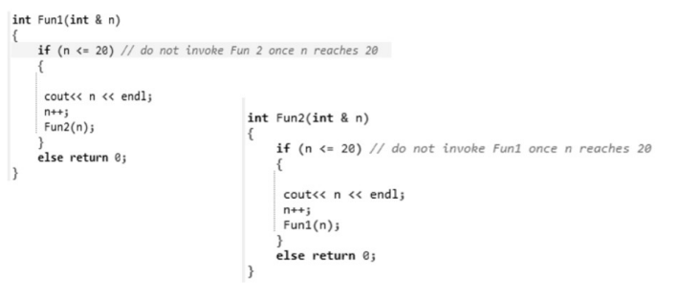
Indirect Recursion
Indirect Recursion is characterized by two of more distinct functions repeatedly call each other. Hence a recursive phenomena is there.

Slide 37
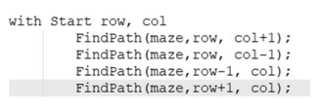
Excessive Recursion
Generally while solving a maze, the allowable movements are left, right, up, down (diagonal also allowed), 4 (8) in number.

Slide 38
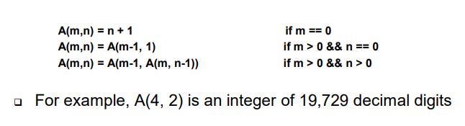
Nested Recursion
When a recursive function call is embedded into a recursive function, it is called “Nested Recursion”
Example of nested recursion is Ackerman function:

Slide 39
What is backtracking?
Backtracking is a search technique for solving complex problems by recursively exploring combinations of possible choices to arrive at a solution.
It is commonly used to solve search, optimization, planning and gaming problems. Backtracking is based on an in-depth search that explores options until a solution is found or all possibilities have been exhausted.

Slide 40
How Backtracking Works
Start with an empty solution and build it one step at a time.
At each step, check if adding the current choice is valid:
If yes, move to the next step.
If no, backtrack by removing the current choice and trying another one.
Repeat until all possibilities are explored or a valid solution is found.

Slide 41
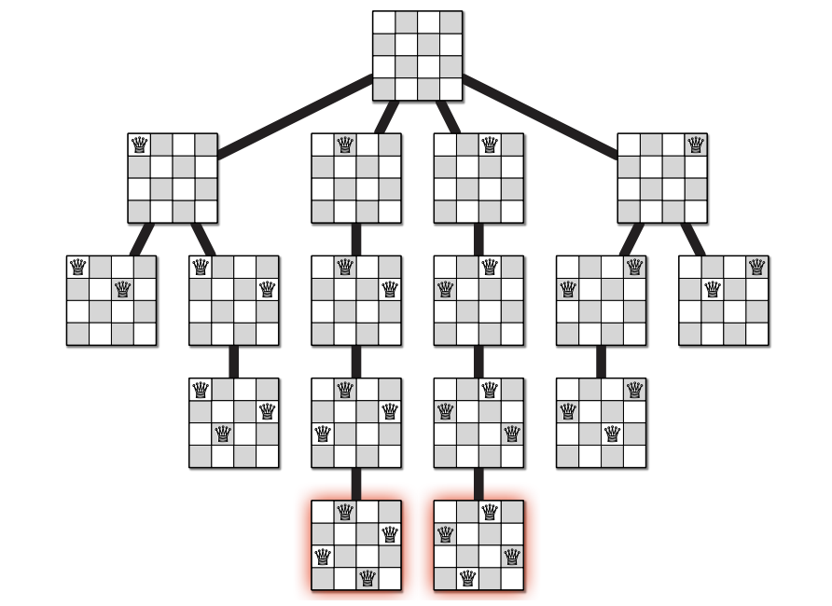
Real-World Problem: N-Queens
Problem: Place 𝑛n queens on an nxn chessboard such that no two queens threaten each other.
Backtracking Approach:
Place queens row by row.
After placing a queen, check if it leads to a valid configuration.
If not, backtrack and try placing the queen in another column.

Slide 42
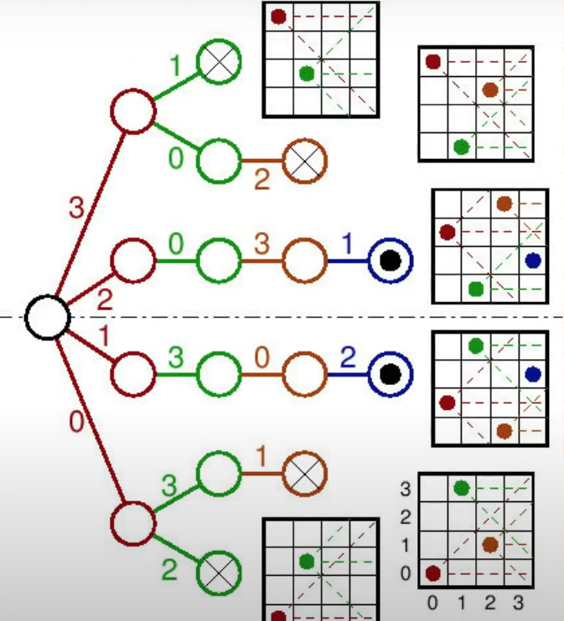
Queue

Slide 43
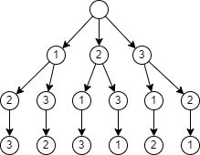
Permutation
List of numbers = [1,2,3]
All possible permutations
[[1,2,3], [1,3,2],[2,1,3],[2,1,3], [3,1,2],[3,2,1]]
____ ____ _____
3 2 1 = 6

Slide 44
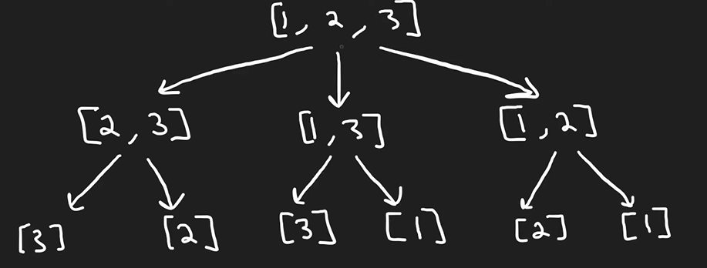

Slide 45
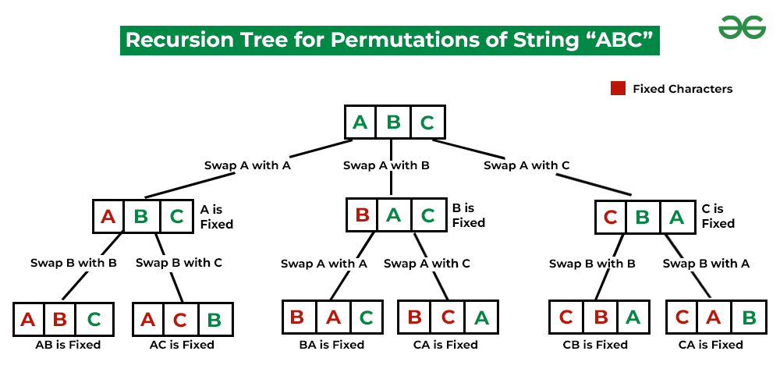
Backtracking – Permutation of a string
A permutation also called an “arrangement number” or “order,” is a rearrangement of the elements of an ordered list S into a one-to-one correspondence with S itself. A string of length N has N! permutations.
Input: S = “ABC”
Output: “ABC”, “ACB”, “BAC”, “BCA”, “CBA”, “CAB”

Slide 46
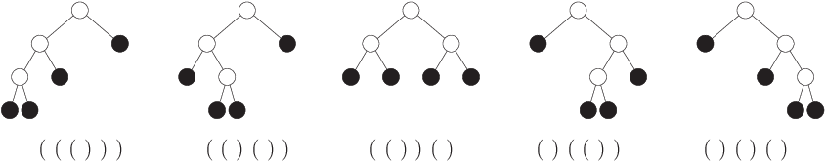
If you have 3 pairs of parentheses, you need to generate all valid sequences with exactly 3 opening '(' and 3 closing ')' parentheses.

Slide 47
Backtracking is used to explore all potential valid combinations of parentheses.
The algorithm explores all possibilities (both adding '(' and ')'), but it prunes invalid paths (those where there are more close brackets than open brackets).
The tree structure helps visualize the recursive decisions made at each step, and backtracking ensures that the algorithm does not explore invalid combinations further.

Slide 48
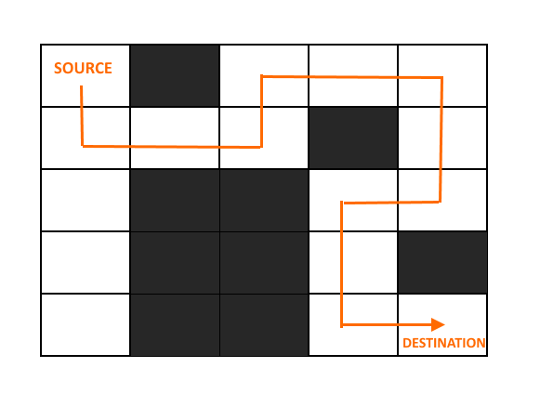
Backtracking - Rat In A Maze Puzzle
To solve a maze using backtracking with marking visited paths, the algorithm needs to keep track of the cells it has already visited. This ensures that the algorithm doesn't repeatedly explore the same path, thereby improving efficiency.

Slide 49
Algorithm:
If the rat reaches the destination
Print the solution matrix.
Else:
Mark the current cell in the solution matrix as 1.
Move downwards and recursively check if this movement leads to the solution.
If movement in the above step doesn't lead to the solution then go towards the right and recursively check if this movement leads to the solution.
If movement in the above step doesn't lead to the solution then move upwards and recursively check if this movement leads to the solution.
If movement in the above step doesn't lead to the solution then move in the left direction and recursively check if this movement leads to the solution.
If none of the above solutions works then BACKTRACK and mark the current cell as 0.
In each recursive call, check the conditions like the rat is not crossing the matrix boundaries and not visiting the already visited cell.
If the rat runs out of options, return false because it's not possible to reach to the destination

Slide 50
Reference
Books:
Data Structures and Algorithms in C++ by Adam Drozdek”
Robert Sedgewick - Algorithms in C++, Parts 1-4_ Fundamentals, Data Structure, Sorting, Searching, Third Edition-Addison-Wesley Professional (1998).
Website: geek for geek

